Slide 1
IS5542 — Generative Artificial Intelligence for Business
Lecture 1

Slide 2





Introducing myself…
Joined Google in 2019
Why I join Google?
2015
2017 Oct
40 days
Andy Chow
Head of Customer Solution Architects
Google Cloud HK
2017 Dec
9 hours
Graduate Certificate of AI

Slide 3






Course Instructor: Miao Yu
Research and teaching focus
I study how algorithms shape behavior
and build trustworthy AI for practice.
Assistant Professor, CityUHK
Ph.D. in IS, HKU
M.S., Michigan Ross
B.S., Nankai University
Dr. Miao YU
Methods
LLMs • RAG • Agentic AI
Assistant Professor
City University of Hong Kong
Industry
Notes:
[Sources]
- https://miaoyuu.github.io/
[/Sources]

Slide 4

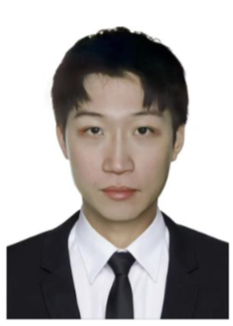

Course Teaching Assistants
Zhanye (Charles) Li
Contact: zhanyeli2-c@my.cityu.edu.hk
Support: Manage activities on Canvas and handle students' inquiries
Ningzhe Zhou
Contact: ningzhe.zhou@my.cityu.edu.hk
Support: Provide on-site support, manage activities on Canvas

Slide 5

Module 1: GenAI Foundations (2–3 Weeks)
• Core GenAI concepts, paradigms, and terminology
• How LLMs work: tokens, attention, context, and generation
• Design, train, and evaluate GenAI systems across tasks
• Conversational agents and business applications
• Limitations, evaluation, and responsible use
Notes:
[Sources]
- https://www.cityu.edu.hk/catalogue/pg/202526/course/IS5542.pdf
[/Sources]

Slide 6
Module 2: GenAI Strategy and Rollout (2–3 Weeks)
• Identify opportunities and define the business case
• Build an implementation roadmap and operating model
• Select architecture, evaluation metrics, and quality controls
• Prepare people, processes, governance, and change management
Notes:
[Sources]
- https://www.cityu.edu.hk/catalogue/pg/202526/course/IS5542.pdf
[/Sources]

Slide 7

Module 3: GenAI Industry Use Cases (4 Weeks)
• Guest talks and practitioner case studies
• Marketing and customer experience
• Internal efficiency and operations
• Financial services and insurance
• Retail and other data-intensive services
Notes:
[Sources]
- https://www.cityu.edu.hk/catalogue/pg/202526/course/IS5542.pdf
[/Sources]

Slide 8
Module 4: Responsible AI (2 Weeks)
• Ethical, societal, and human-impact considerations
• Privacy, security, copyright, and data governance
• Guest case: security in GenAI implementation
• Emerging models, agents, and multimodal systems
• Course synthesis, revision, and discussion
Notes:
[Sources]
- https://www.cityu.edu.hk/catalogue/pg/202526/course/IS5542.pdf
[/Sources]

Slide 9
Lecture Dates (Tentative)
Module 1 – Intro to GenAI
  Sep 5, 12, 19
Module 2 – Strategic Implementation (Guest Lectures-CMC M3017)
  Oct 10: Design Thinking
  Oct 17
Module 3 – Industry Use Cases (Guest Lectures-CMC M3017)
  Oct 24: FSI Sharing
  Oct 31
  Nov 7
  Nov 14: Legal Industry
Module 4 – Responsible AI and Future
  Nov 21, 28

Slide 10
Course Assessment
• Participation and exercises (20%):
-post-lecture reflections are graded （3✖️6=18%）
- participation 2%
• Group project (30%)
Project presentation
• Written examination (50%; 2 hours)
Notes:
[Sources]
- https://www.cityu.edu.hk/catalogue/pg/202526/course/IS5542.htm
- https://www.cityu.edu.hk/catalogue/pg/202526/course/IS5542.pdf
[/Sources]
[Sources]
- https://www.cityu.edu.hk/catalogue/pg/202627/course/IS5542.pdf (assessment weights and minimum passing requirements; accessed 2026-08-22)
[/Sources]

Slide 11

Group Project: Defensible GenAI Application
Teams of 5–7 students
Define a specific business problem and affected stakeholders
Design the GenAI workflow, data sources, and rollout plan
Evaluate business value, model quality, cost, and risk
Presentation should include the following:
Business context and target users
Architecture, evaluation metrics, and expected outcomes
PROBLEM • WORKFLOW • DEMO
Demo, or storyboard
Notes:
[Sources]
- https://www.cityu.edu.hk/catalogue/pg/202526/course/IS5542.pdf
[/Sources]
[Sources]
- https://unsplash.com/photos/diverse-group-of-students-collaborating-around-a-laptop--X4Qx4_4iMU (student collaboration photo; accessed 2026-09-02)
[/Sources]

Slide 12
Written Examination
• Weighting: 50% of the course grade
• Duration: 2 hours
Multiple choice questions (20%)
Short answer questions (30%)
Essay questions (50%)
-Concepts covered in the lectures
-Case study questions on how to apply those concepts
• Exact question format will be confirmed by the instructor
Notes:
[Sources]
- https://www.cityu.edu.hk/catalogue/pg/202526/course/IS5542.htm
[/Sources]

Slide 13
Part 1
Foundations of Generative AI
Notes:
Choosing an enterprise architecture is an optimization problem, not a model leaderboard contest. Capability must match the task and modality. Latency and throughput affect user experience and infrastructure. Cost and governance determine whether the system can operate sustainably. These goals may conflict. A more capable model may be slower, more expensive, or harder to control. The design objective is therefore the best overall system for the mission, not the strongest model considered in isolation.
[Sources]
- Adapted and neutralized from GenAI in Business IS5542 - Lecture 1-2025.pptx, slide 53.
[/Sources]

Slide 14

Module 1: Foundations
What is Generative AI?
Gemini Prompt: Create an image of an AI Brain

Slide 15




Source: https://www.forbes.com/sites/bernardmarr/2024/07/30/generative-ai-myths-the-5-biggest-misunderstandings/
Notes:
Is it ChatGPT?
No GenAI is not just ChatGPT or only a Chatbot
Is it Intelligent?
Yes and No, depends on how you look at it, its a function of probability that predict what is the most likely next word based on the training dataset
It only create words and pictures?
No it can create music, video, model, and many different forms of data
Is it New?
No its not new, we have a long history of AI and the concepts of AI chatbots can trace back to the 1950s

Slide 16
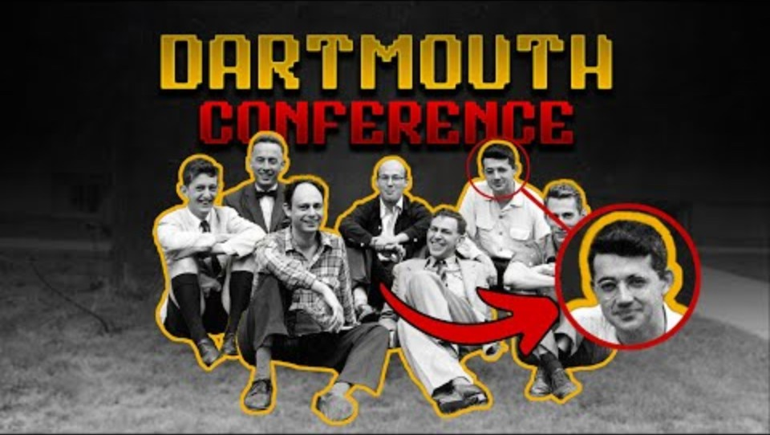
Is AI New?
https://youtu.be/5Ur-Nf85ARw?si=3xWSmEZ7LsxVMgPp&t=187

Slide 17
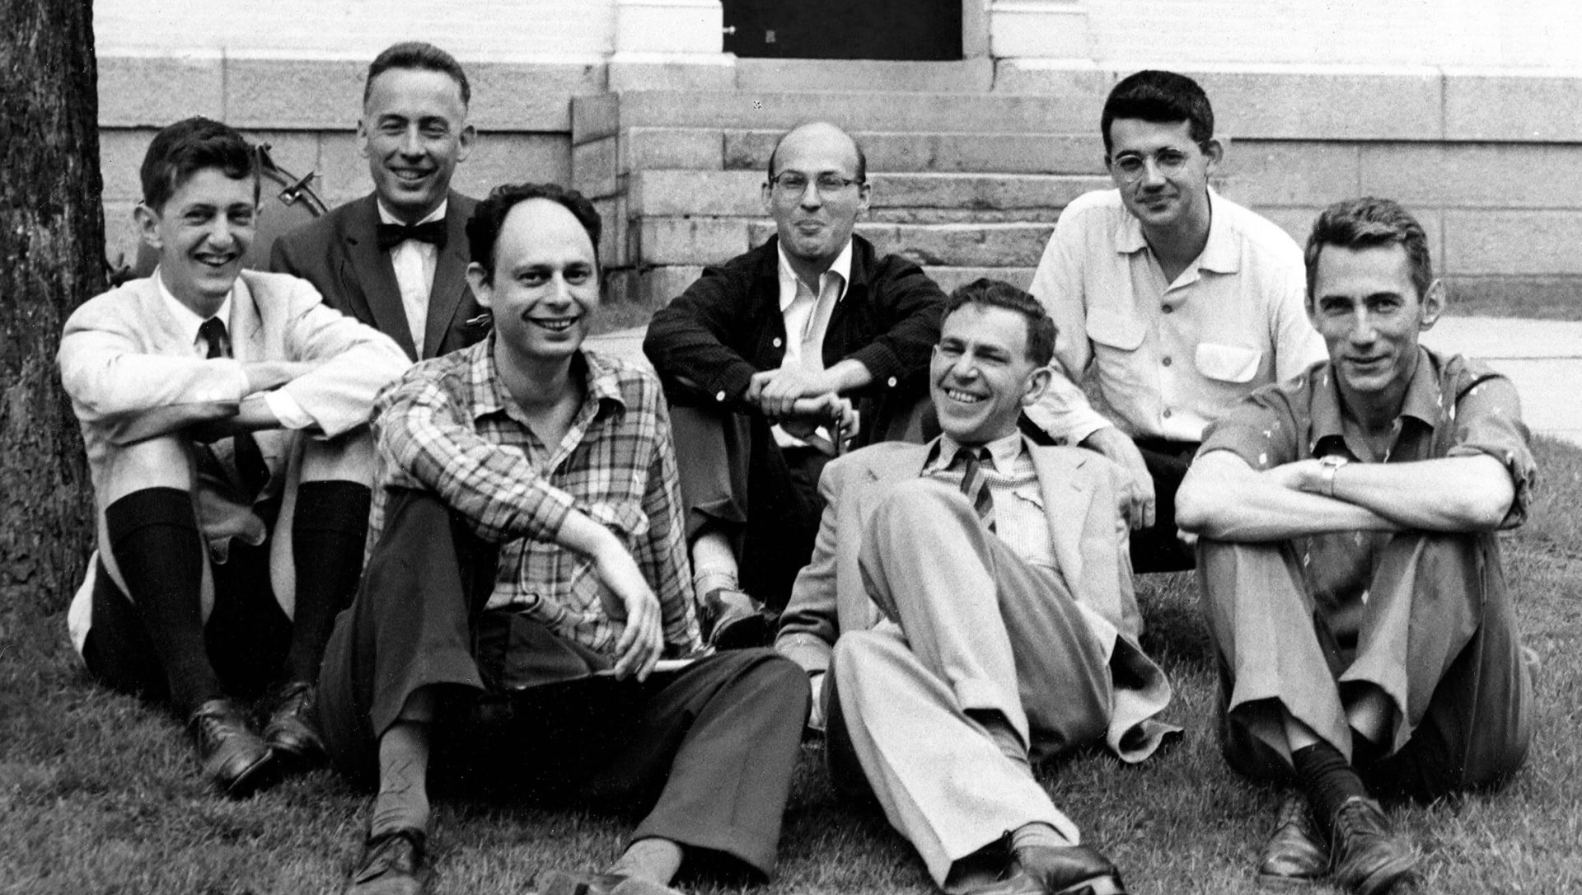
Is AI New?
1956
The term “artificial intelligence” entered the research agenda decades before today’s generative models.
AI is not new; today’s capabilities are the result of several paradigm shifts.
Notes:
[Sources]
- https://www.startechup.com/blog/machine-learning-history/
[/Sources]

Slide 18

Is it a chatbot or chatgpt?

Slide 19
Chatbot Is a Category; ChatGPT Is One Product
Conversational interfaces can be implemented with rules, retrieval, predictive models, or generative language models.
Chatbot
ChatGPT
A broad category of conversational software
May use scripted rules, menus, retrieval, or machine learning
Capability depends on the system behind the interface
A specific conversational product built on OpenAI models
Generates responses from learned language distributions
Can be combined with retrieval, tools, and business controls
Do not infer the architecture or capability of a system from the word chatbot alone.
Notes:
[Sources]
- Adapted and neutralized from GenAI in Business IS5542 - Lecture 1-2025.pptx, slide 26.
[/Sources]

Slide 20
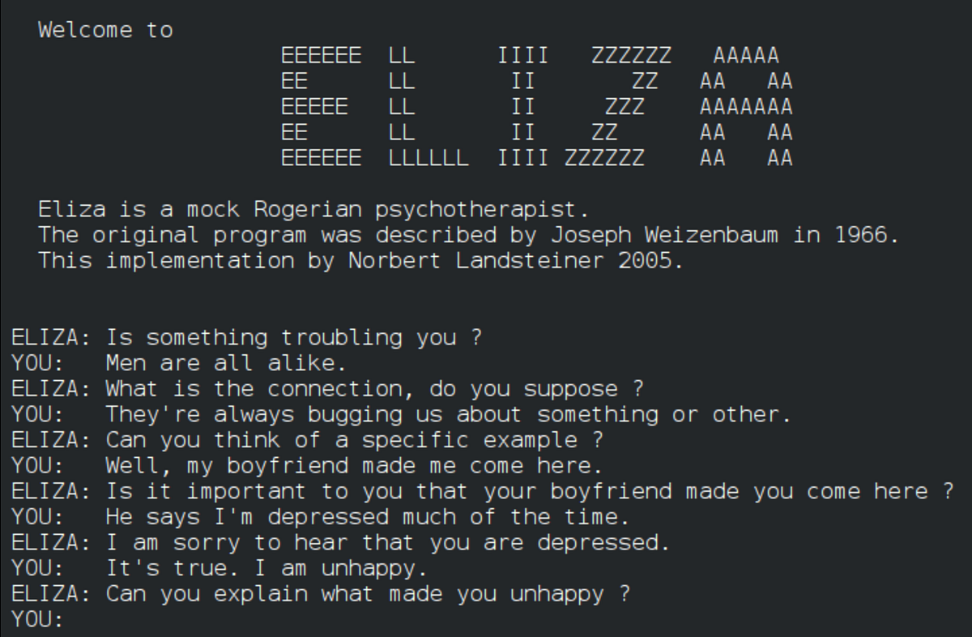
ELIZA: A Rule-Based Conversation Program
PATTERN MATCHING
SCRIPTED RULES
REFLECTIVE REPLY
ELIZA simulated understanding through rules—an early lesson in anthropomorphism.
Notes:
[Sources]
- https://tsaiprabhanj.medium.com/eliza-the-early-days-of-language-models-6d4b2336c22a
[/Sources]

Slide 21
ELIZA Showed How Easily Rules Can Feel Conversational
Joseph Weizenbaum created ELIZA at MIT in 1964–1966; the DOCTOR script simulated a reflective psychotherapist.
How it worked
Why it mattered
Matched keywords and scripted patterns
Transformed phrases into reflective questions
Did not understand meaning or learn from dialogue
Users attributed empathy and intelligence—the ELIZA effect
The reaction raised ethical questions about human–machine interaction
Later conversational systems included PARRY, ALICE, virtual assistants, and LLM chatbots
ELIZA’s power came from the user’s interpretation, not genuine understanding.
Notes:
[Sources]
- Adapted and neutralized from GenAI in Business IS5542 - Lecture 1-2025.pptx, slide 26.
[/Sources]

Slide 22
How AI Evolved: Three Milestones
A simplified learning path highlights three milestones in how machines represent knowledge, learn patterns, and create content.
Symbolic AI: explicit rules and traceable reasoning
Deep learning: statistical patterns learned from data
Generative AI: autonomous production of text, images, code, and audio
The enabling resources also changed—from curated rules, to big data and GPUs, to foundation models and scalable inference.
Notes:
[Sources]
- Adapted and neutralized from GenAI in Business IS5542 - Lecture 1-2025.pptx, slide 23.
[/Sources]

Slide 23
Three Milestones in AI's Evolution
These milestones summarize major capability shifts; the four-paradigm view separates Statistical ML from Deep Learning.
1. Symbolic AI
2. Deep Learning
3. Generative AI
Encode knowledge as symbols, logic, and if–then rules. Best when the problem is structured and the reasoning path must be visible.
Learn statistical representations from data. Excels at perception, classification, prediction, and pattern recognition.
Use foundation models to produce new content and interact through natural language across many business tasks.
Understanding the transitions explains both the capabilities and the limits of modern AI.
Notes:
[Sources]
- Adapted and neutralized from GenAI in Business IS5542 - Lecture 1-2025.pptx, slide 24.
[/Sources]

Slide 24
Four AI Paradigms Coexist and Evolve
A more complete view separates Statistical ML from Deep Learning; all four paradigms continue to coexist.
SYMBOLIC AI
STATISTICAL ML
DEEP LEARNING
FOUNDATION MODELS
Explicit rules and search; transparent but brittle when exceptions multiply.
Learns predictive patterns from data; performance depends on representative examples.
Learns representations from unstructured data; requires substantial data and compute.
Pretrained generative models adapt across tasks, modalities, and business workflows.
Modern enterprise systems often combine rules, predictive models, foundation models, retrieval, and tools.
Notes:
[Sources]
- https://www.nist.gov/publications/artificial-intelligence-risk-management-framework-ai-rmf-10
[/Sources]

Slide 25
Symbolic AI Made Reasoning Explicit
From the 1950s to the 1980s, knowledge was represented with symbols, rules, and logical operators.
How it worked
Where it worked best
Rule-based reasoning used explicit if–then logic.
Search and planning followed a defined state space.
Expert systems encoded specialist knowledge for repeatable decisions.
Classification and planning with clear rules
Structured domains such as finance and medicine
Auditable settings where each reasoning step must be traced
Strength: transparency. Limitation: brittle performance when rules cannot cover real-world ambiguity.
Notes:
[Sources]
- Adapted and neutralized from GenAI in Business IS5542 - Lecture 1-2025.pptx, slide 26.
[/Sources]

Slide 26
Symbolic AI Worked When Rules Were Explicit
Symbolic systems converted expert knowledge into rules and search procedures.
Business value
Boundary
Repeatable decisions in structured domains
Transparent logic and traceable reasoning
Useful for expert systems, planning, and compliance
Rules had to be written and maintained by people
Ambiguity and unstructured data were difficult
Coverage deteriorated as exceptions multiplied
Symbolic AI delivered control, but not broad adaptability.
Notes:
[Sources]
- Adapted and neutralized from GenAI in Business IS5542 - Lecture 1-2025.pptx, slide 26.
[/Sources]

Slide 27
Symbolic AI Hit a Scalability Wall
Early AI winters followed a gap between ambitious promises and systems that were costly, brittle, and narrow.
Why performance stalled
What the field learned
Rule bases expanded faster than teams could maintain them
Perception and speech remained unreliable
Limited compute and data constrained progress
Knowledge engineering alone did not scale
Learning from data became increasingly important
Symbolic methods remained useful for explicit constraints
The lesson was not that rules were useless; rules alone could not cover the real world.
Notes:
[Sources]
- Adapted and neutralized from GenAI in Business IS5542 - Lecture 1-2025.pptx, slide 26.
[/Sources]

Slide 28
Statistical Learning Shifted AI from Rules to Data
Machine learning estimates patterns from examples instead of requiring every decision rule to be hand-coded.
What changed
New dependencies
Models learned features or parameters from examples
Performance became measurable on held-out data
Generalization became an empirical question
Representative and lawful data
Sufficient compute and engineering
Monitoring for drift and changing conditions
The paradigm traded explicit rules for data-dependent performance.
Notes:
[Sources]
- Adapted and neutralized from GenAI in Business IS5542 - Lecture 1-2025.pptx, slide 30.
[/Sources]

Slide 29
AI, ML, and Deep Learning
Each term is a narrower subset of the one before it.
ARTIFICIAL INTELLIGENCE
MACHINE LEARNING
DEEP LEARNING
AI is the broad goal; ML learns from data; deep learning learns layered representations.
Notes:
[Sources]
- Adapted and neutralized from GenAI in Business IS5542 - Lecture 1-2025.pptx, slide 32.
[/Sources]

Slide 30

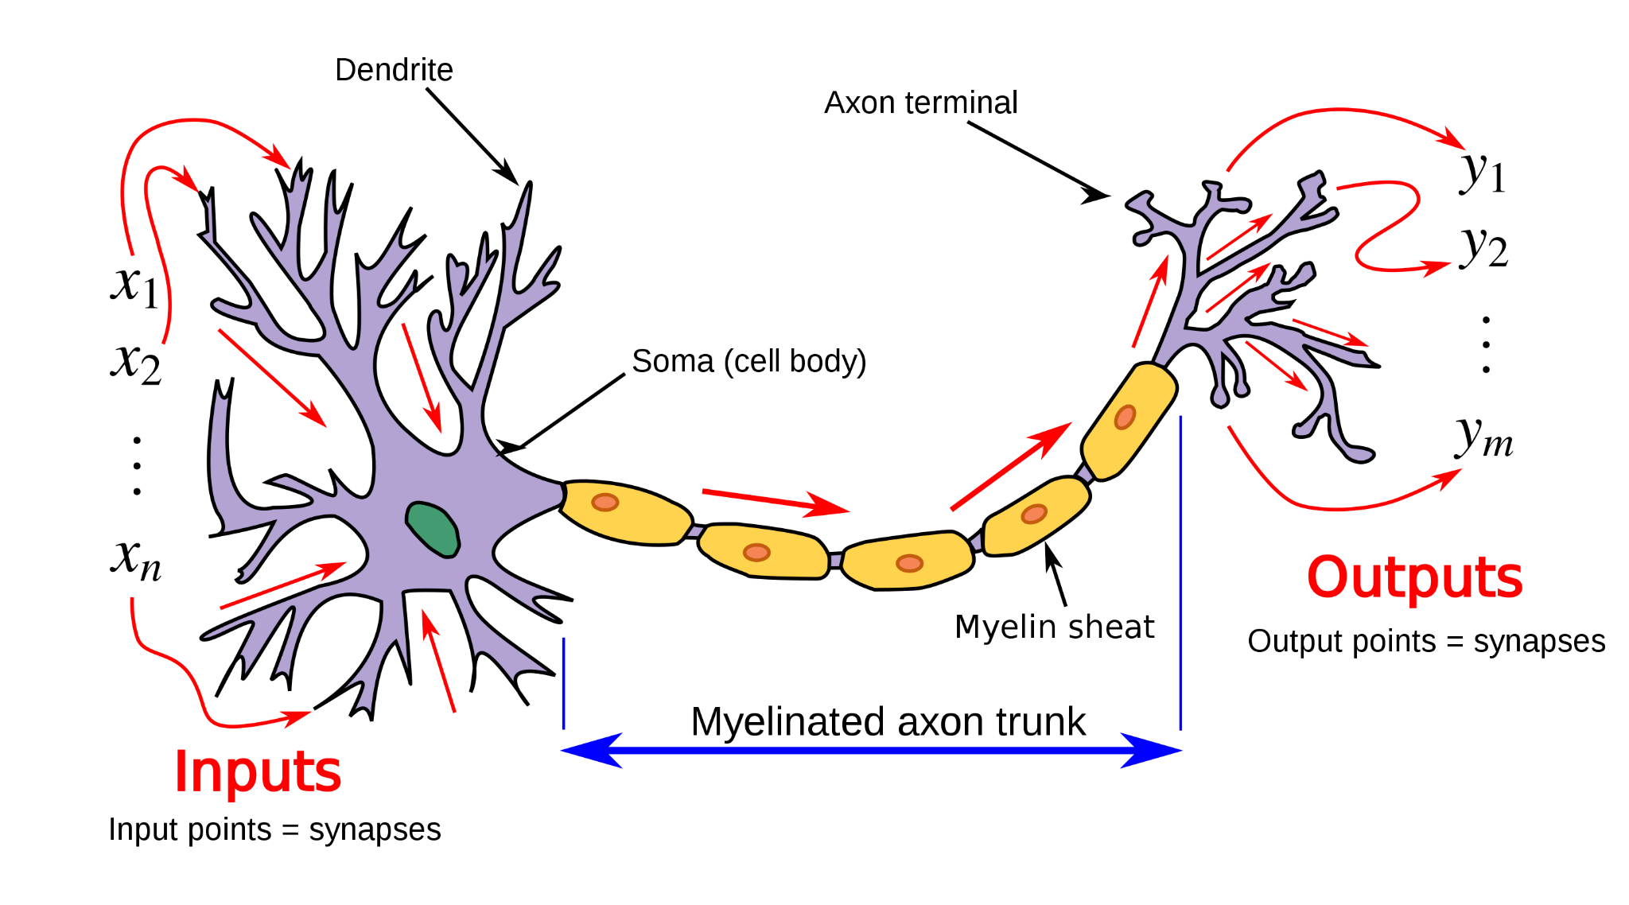
Neurons
Weights
Output
Input
Updates

Slide 31
Supervised Learning Maps Labeled Inputs to Predictions
The target type determines the model objective and evaluation metric.
CLASSIFICATION
REGRESSION
category
continuous value
Classification predicts a class; regression predicts a numeric value.
Notes:
[Sources]
- Adapted and neutralized from GenAI in Business IS5542 - Lecture 1-2025.pptx, slide 26.
[/Sources]

Slide 32
Deep Learning Learned Patterns from Data
From roughly 2012 to 2017, multi-layer neural networks shifted AI from hand-coded rules to learned representations.
Core paradigm
Key enablers
Many layers extract increasingly complex features.
The objective is usually discriminative: identify, classify, or predict.
Examples include facial recognition, forecasting, and medical imaging.
Big data supplied diverse examples for training.
GPUs made large-scale parallel computation practical.
Improved optimization and architectures stabilized training.
Deep learning reduced the need for explicit feature engineering, but increased dependence on data and compute.
Notes:
[Sources]
- Adapted and neutralized from GenAI in Business IS5542 - Lecture 1-2025.pptx, slide 30.
[/Sources]

Slide 33
Deep Learning Made Representation Learning Practical
Multi-layer networks learned features directly from large datasets, reducing manual feature engineering.
Where it excelled
What made it possible
Vision, speech, and language
Classification and prediction at scale
Unstructured data with complex patterns
GPUs and distributed compute
Large labeled and unlabeled datasets
Better activations, regularization, and architectures
Deep learning scaled perception by learning representations and task behavior together.
Notes:
[Sources]
- Adapted and neutralized from GenAI in Business IS5542 - Lecture 1-2025.pptx, slide 30.
[/Sources]

Slide 34
AlexNet Proved Deep Learning at Scale
AlexNet combined scale, GPU training, and a deeper convolutional architecture.
Image
224×224
Conv + ReLU
Pooling
Conv blocks
Fully connected
1,000 classes
GPU-accelerated training
ImageNet 2012: top-5 error 15.3%
The breakthrough came from architecture + compute + data—not from one ingredient alone.
Notes:
[Sources]
- https://papers.nips.cc/paper/4824-imagenet-classification-with-deep-convolutional-neural-networks.pdf
[/Sources]

Slide 35

AlexNet Proved Deep Learning at Scale
ImageNet task: rank the most likely labels for an unseen 224 × 224 image drawn from 1,000 object categories.
Conv + ReLU
Pooling
Conv blocks
Fully connected
5 convolutional layers • 3 fully connected layers • ≈60M parameters • GPU training
TOP-5 PREDICTIONS (illustrative)
1 Golden retriever 72%
2 Labrador retriever 18%
3 Kuvasz 4%
4 Tennis ball 2%
5 Other dog breed 1%
INPUT IMAGE • 224 × 224 RGB
ImageNet 2012: top-5 error 15.3% — an error occurs only when the true label is missing from all five predictions.

Slide 36
Inception and Residual Connections Enabled Deeper Networks
A shortcut lets a block learn the residual change instead of rebuilding the full signal.
identity shortcut
x
Conv
+ ReLU
Conv
+
F(x) + x
Residual connections preserve information and make much deeper networks trainable.
Notes:
[Sources]
- https://openaccess.thecvf.com/content_cvpr_2016/html/He_Deep_Residual_Learning_CVPR_2016_paper.html
[/Sources]

Slide 37

Compute, Data, and Architecture Reinforced One Another
The 2012 deep-learning inflection came from three mutually reinforcing resources—not one invention.
GPUs
Large datasets
Architectures
Parallel hardware made large neural-network training dramatically faster.
ImageNet-scale labeled data made comparison and generalization measurable.
Convolutions, ReLU, dropout, and later residual connections improved optimization.
GPU PARALLELISM • DATA SCALE • ARCHITECTURE
AlexNet made the combined effect visible; later architectures extended it.
Notes:
[Sources]
- https://papers.nips.cc/paper/4824-imagenet-classification-with-deep-convolutional-neural-networks.pdf
[/Sources]
[Sources]
- https://unsplash.com/photos/cable-network-M5tzZtFCOfs (data-center infrastructure photo; accessed 2026-09-02)
[/Sources]

Slide 38
Geoffrey Hinton Helped Make Deep Learning Practical
Hinton’s work connected brain-inspired computation with trainable neural networks; he shared the 2024 Nobel Prize in Physics with John Hopfield.
Foundational contributions
Career and recognition
Distributed representations and backpropagation research
Boltzmann machines, deep belief networks, and mixtures of experts
The Toronto team whose work led to AlexNet’s 2012 breakthrough
Cambridge and Edinburgh training; long career at the University of Toronto
CIFAR leadership and Google/DNNresearch from 2013 to 2023
2018 Turing Award and 2024 Nobel Prize in Physics
Hinton helped turn neural networks from a long-term research program into a practical foundation for modern AI.
Notes:
[Sources]
- https://www.nobelprize.org/prizes/physics/2024/hinton/
[/Sources]

Slide 39
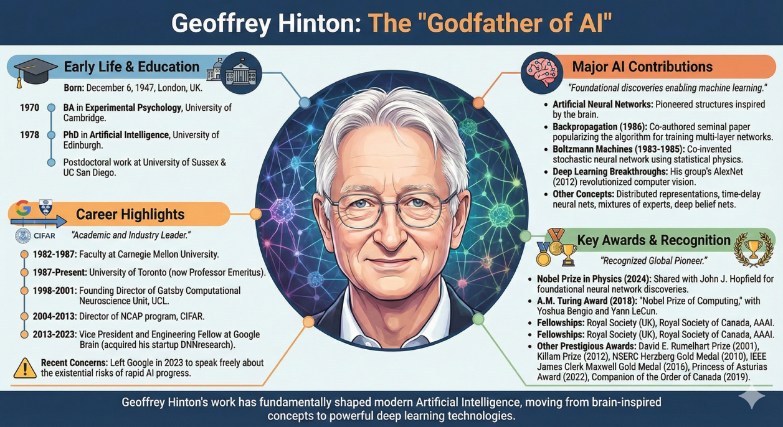
Who is Geoffrey Hinton?

Slide 40

Watch: Geoffrey Hinton’s Nobel Lecture
DEEP-LEARNING MILESTONE
Use this segment to connect the history of neural networks with the methods that made modern foundation models practical.
Listen for how research ideas became scalable learning systems.
youtube.com/watch?v=-f5WQAk3dYo&t=23s
Notes:
[Sources]
- https://www.youtube.com/watch?v=-f5WQAk3dYo&t=23s

Slide 41
Language Meaning Depends on Context
Unlike a fixed numeric feature vector, language combines ambiguity, sequence, syntax, and world knowledge.
Same form, different meaning
Why sequence matters
Words can have multiple senses
Pronouns and references depend on earlier text
Tone and intent may be implicit
Word order changes meaning
Long-range dependencies connect distant phrases
Small interpretation errors can compound across a document
Language models need representations that capture both token identity and surrounding context.
Notes:
[Sources]
- Adapted and neutralized from GenAI in Business IS5542 - Lecture 1-2025.pptx, slide 26.
[/Sources]

Slide 42
One-Hot Encoding Made Words Sparse and Isolated
A one-hot vector identifies a token but says nothing about similarity or context.
bank
river
money
loan
water
bank
1
0
0
0
0
Sparse
Vocabulary-size vector
e.g., 100K dimensions
river
0
1
0
0
0
money
0
0
1
0
0
loan
0
0
0
1
0
No semantic distance
water
0
0
0
0
1
Embeddings replace isolated identity codes with dense, learned representations.
Notes:
[Sources]
- Adapted and neutralized from GenAI in Business IS5542 - Lecture 1-2025.pptx, slide 26.
[/Sources]

Slide 43
Input Processing Turns Text into Contextual Vectors
Modern language models transform raw text through three linked representation steps.
TEXT
Generative AI
TOKENS
Gener | ative | AI
EMBEDDINGS
Dense vectors
CONTEXT
Position + attention
Tokens are discrete units; embeddings encode features; context changes meaning.
Notes:
[Sources]
- Adapted and neutralized from GenAI in Business IS5542 - Lecture 1-2025.pptx, slide 54.
[/Sources]

Slide 44
Why Recurrent Models Lose Long Context
Recurrent models process tokens sequentially, creating a long path for distant information.
Token 1
Hidden state
Token 2
Hidden state
…
Token n
Long dependency path
The search for global context and parallel training set the stage for the Transformer.
Notes:
[Sources]
- Adapted and neutralized from GenAI in Business IS5542 - Lecture 1-2025.pptx, slide 39.
[/Sources]

Slide 45
Transformers Shifted AI Toward Generation
The Transformer replaces recurrent training with parallel attention over tokens.
The
bank
approved
the
loan
MULTI-HEAD
SELF-ATTENTION
Contextual token representations
Attention connects every token to relevant context during parallel training.
Notes:
[Sources]
- https://arxiv.org/abs/1706.03762
[/Sources]
[Sources]
- https://papers.nips.cc/paper/7181-attention-is-all-you-need
[/Sources]

Slide 46
Self-Attention Connects Tokens During Parallel Training
Each token can attend to different tokens with different strengths.
The
bank
approved
the
loan
The
bank
approved
the
loan
Example: “loan” attends strongly to “bank” and “approved.”
Attention weights are learned relationships—not fixed dictionary meanings.
Notes:
[Sources]
- https://arxiv.org/abs/1706.03762
[/Sources]
[Sources]
- https://papers.nips.cc/paper/7181-attention-is-all-you-need
[/Sources]

Slide 47
LLM Architecture Balances Attention, Context, and Serving
An LLM converts tokens into contextual representations and generates outputs under compute and latency constraints.
Tokens & embeddings
Multi-head attention
Context & serving
Encode discrete text units as dense vectors with positional information.
Learn several relationship patterns between token positions in parallel during training.
Context length, decoding, batching, hardware, and cost shape the user experience.
Scalability comes from the whole architecture—not attention or parameter count alone.
Notes:
[Sources]
- Adapted and neutralized from GenAI in Business IS5542 - Lecture 1-2025.pptx, slide 54.
[/Sources]

Slide 48
Transformers Remove Recurrence in Training
Transformers remove recurrent hidden-state updates during training.
RECURRENT
TRANSFORMER
A → B → C → D
Sequential dependency
Harder to parallelize
All tokens ↔ attention
Parallel training
Direct long-range links
Training becomes parallel, while generation still proceeds token by token.
Notes:
[Sources]
- https://arxiv.org/abs/1706.03762
[/Sources]

Slide 49
LLMs Generate One Token at a Time
At each step, the model predicts a distribution over the next token.
Prompt
Context state
Next-token probabilities
Select token
Append + repeat
Fluent generation is probabilistic pattern completion—not guaranteed factual understanding.
Notes:
[Sources]
- Adapted and neutralized from GenAI in Business IS5542 - Lecture 1-2025.pptx, slide 47.
[/Sources]

Slide 50
Decoding Samples from a Next-Token Distribution
Decoding changes how a probability distribution becomes the next token.
mat
80%
The cat sat on the…
hat
15%
floor
5%
Temperature and sampling expose a controllable trade-off between consistency and diversity.
Notes:
[Sources]
- Adapted and neutralized from GenAI in Business IS5542 - Lecture 1-2025.pptx, slide 47.
[/Sources]

Slide 51
An LLM Is a Large, Pretrained Language Model
LLMs learn statistical regularities from large-scale data and can be adapted to many downstream workflows.
SCALE
PRETRAINING
ADAPTATION
Substantial parameters, data, and compute support broad pattern learning.
Self-supervised objectives learn reusable linguistic and task-related representations.
Prompting, retrieval, fine-tuning, and tools specialize behavior for a business task.
General-purpose adaptation is common, but it is not part of the formal definition of every LLM.
Notes:
[Sources]
- Adapted and neutralized from GenAI in Business IS5542 - Lecture 1-2025.pptx, slide 54.
[/Sources]

Slide 52
2017–Present: Foundation Models Expanded Generation
Transformers enabled scalable foundation models; the commercial GenAI wave accelerated after widely accessible chat interfaces appeared.
Technical shift
Business shift
Self-attention and parallel training
Large-scale pretraining
Reusable models across many tasks
Natural-language interfaces
Text, code, image, and audio generation
Models used as shared platforms
2017 marks the Transformer era—not the beginning of all generative modeling.
Notes:
[Sources]
- https://arxiv.org/abs/1706.03762
[/Sources]

Slide 53

Watch: What Makes AI Generative?
CAPABILITY CHECK
Generative models produce new outputs from learned probability distributions instead of selecting only from fixed responses.
Relate the explanation to tokens, decoding, and multimodality.
youtube.com/watch?v=Px3HfB2UkyU&t=2906s
Notes:
[Sources]
- https://www.youtube.com/watch?v=Px3HfB2UkyU&t=2906s
[/Sources]

Slide 54

Discussion: Why Can AI Feel Alive?
HUMAN INTERPRETATION
Fluent conversation can trigger anthropomorphism, but social behavior is not evidence of consciousness or genuine understanding.
What evidence would be needed before making a stronger claim?
youtube.com/watch?v=oMpNIz9AIu0&t=43s
Notes:
[Sources]
- https://www.youtube.com/watch?v=oMpNIz9AIu0&t=43s
[/Sources]

Slide 55







The GenAI Landscape Is a Portfolio, Not a Ranking
Model families differ by capability, control, deployment, and economics.
ChatGPT
Gemini
Claude
Copilot
Qwen
DeepSeek
Grok
Treat product names as time-stamped examples; use durable decision categories.
Notes:
[Sources]
- Adapted and neutralized from GenAI in Business IS5542 - Lecture 1-2025.pptx, slide 72.
[/Sources]
[Sources]
- https://openai.com/brand/
- https://gemini.google.com/
- https://www.anthropic.com/claude
- https://www.microsoft.com/en-us/microsoft-copilot
- https://www.deepseek.com/
- https://qwen.ai/
- https://x.ai/
[/Sources]

Slide 56
Neuro-Symbolic AI Combines Patterns and Logic
Modern neural models are powerful pattern learners, but their reasoning can be opaque and resource intensive.
Neural strengths
Symbolic strengths
High-capacity perception and pattern recognition
Flexible content generation
Learning from unstructured data at scale
Explicit rules and constraints
Traceable reasoning paths
Reliable execution in structured domains
Hybrid systems aim to combine neural flexibility with interpretable, controllable logic for high-stakes use.
Notes:
[Sources]
- Adapted and neutralized from GenAI in Business IS5542 - Lecture 1-2025.pptx, slide 49.
[/Sources]

Slide 57
Opacity Changes How Enterprises Establish Trust
The model’s internal representations are difficult to interpret completely, but the surrounding system can still be made accountable.
Hard to observe
Can be audited
The internal cause of a specific output
Behavior changes after updates
The influence of individual training examples
Sources, prompts, and model versions
Tool calls, rules, and approvals
Evaluations, incidents, and monitoring results
Trust comes from evidence and controls around the model—not a claim that its hidden reasoning is visible.
Notes:
[Sources]
- Adapted and neutralized from GenAI in Business IS5542 - Lecture 1-2025.pptx, slide 49.
[/Sources]

Slide 58
Trustworthy AI Combines Capability, Evidence, and Control
Enterprise deployment requires more than a capable model: the system must support reliable decisions and accountable operations.
Capability
Evidence
Control
Measure task accuracy, robustness, latency, and cost on representative workloads.
Ground outputs in approved data and preserve sources, versions, and evaluation results.
Apply permissions, monitoring, human review, and incident response according to risk.
A strong model is only one component of a trustworthy business system.
Notes:
[Sources]
- Adapted and neutralized from GenAI in Business IS5542 - Lecture 1-2025.pptx, slide 54.
[/Sources]

Slide 59
Part 2
Designing Enterprise GenAI Systems
Notes:
Choosing an enterprise architecture is an optimization problem, not a model leaderboard contest. Capability must match the task and modality. Latency and throughput affect user experience and infrastructure. Cost and governance determine whether the system can operate sustainably. These goals may conflict. A more capable model may be slower, more expensive, or harder to control. The design objective is therefore the best overall system for the mission, not the strongest model considered in isolation.
[Sources]
- Adapted and neutralized from GenAI in Business IS5542 - Lecture 1-2025.pptx, slide 53.
[/Sources]

Slide 60

Enterprise LLMs Require Multi-Objective Design
Choosing an enterprise LLM architecture is an optimization problem, not a model leaderboard contest.
Capability must match the task and modality.
Latency, throughput, and context affect user experience and infrastructure.
Cost and governance determine whether the system can operate sustainably.
TASK FIT • UX • COST • GOVERNANCE
The design goal is the best system for the mission—not the strongest model in isolation.
Notes:
[Sources]
- Adapted and neutralized from GenAI in Business IS5542 - Lecture 1-2025.pptx, slide 53.
[/Sources]
[Sources]
- https://unsplash.com/photos/two-people-collaborating-on-a-whiteboard-with-notes-EPdKKb-hflg (enterprise planning photo; accessed 2026-09-02)
[/Sources]

Slide 61
Six Vectors Shape the Architecture Trade Space
Enterprise architecture is a multi-objective design problem.
Modality
Context
Latency
MISSION
FIT
Throughput
Performance
Cost
Improving one vector can weaken another; prioritize the dominant business failure cost.
Notes:
[Sources]
- Adapted and neutralized from GenAI in Business IS5542 - Lecture 1-2025.pptx, slide 26.
[/Sources]

Slide 62
The Best Model Is Not the Biggest Model
Parameter count is only one signal. Enterprise architects must balance six operational vectors.
Experience
Quality
Economics
Modality and latency determine how users interact with the system.
Performance and effective context determine whether outputs are useful and reliable.
Throughput and cost determine whether the architecture can scale.
An optimal design balances the six vectors for a specific business mission and risk tolerance.
Notes:
[Sources]
- Adapted and neutralized from GenAI in Business IS5542 - Lecture 1-2025.pptx, slide 54.
[/Sources]

Slide 63
Mission Fit Replaced Model-Leaderboard Thinking
As the market matured, the strongest benchmark score stopped being a sufficient deployment criterion.
Benchmark mindset
Mission constraints
Architecture decision
Ask which model is smartest or largest on a public leaderboard.
Define modality, accuracy, latency, context, throughput, cost, privacy, and risk.
Choose the model, retrieval, tools, deployment, and controls that fit the workload.
The best enterprise model is the one that meets the mission within operational and governance constraints.
Notes:
[Sources]
- Adapted and neutralized from GenAI in Business IS5542 - Lecture 1-2025.pptx, slide 54.
[/Sources]

Slide 64
Two Ways to Build Multimodal Systems
A pipeline combines specialized models through explicit interfaces.
TEXT
Specialized
encoders
IMAGE
Specialized
encoders
LLM + tools
Decision
AUDIO
Specialized
encoders
VIDEO
Specialized
encoders
Pipelines offer modular control but add integration and latency overhead.

Slide 65
Pipeline vs Native Multimodality: Key Trade-offs
Native multimodality learns joint representations inside one model.
TEXT
IMAGE
NATIVE
MULTIMODAL MODEL
Joint response
AUDIO
VIDEO
Native models simplify interaction but may reduce component-level control.
Notes:
[Sources]
- Adapted and neutralized from GenAI in Business IS5542 - Lecture 1-2025.pptx, slide 57.
[/Sources]

Slide 66

Multimodality Expands the Business Interface
Text, images, audio, and video can serve as inputs, outputs, or shared evidence within one workflow.
INPUT
REASONING
OUTPUT
Capture documents, claim photos, speech, video, and sensor data.
Relate signals across modalities when business meaning cannot be represented by text alone.
Generate text, speech, images, structured records, or tool actions for the workflow.
CLAIM PHOTO + FORM → CASE RECORD
Use multimodality when it materially improves the task—not simply because a model accepts more media types.
Notes:
[Sources]
- Adapted and neutralized from GenAI in Business IS5542 - Lecture 1-2025.pptx, slide 54.
[/Sources]
[Sources]
- https://www.pexels.com/photo/person-writing-on-a-clipboard-inside-the-vehicle-8943323/ (vehicle-inspection photo; accessed 2026-09-02)
[/Sources]

Slide 67
Latency Has Two Components
Users experience both the wait before the first token and the pace of subsequent tokens.
PREFILL
Time to first token
DECODE
Inter-token latency
Request
TTFT
T1
T2
T3
T4
T5
ITL →
Optimize TTFT and ITL separately against the workload’s service objective.
Notes:
[Sources]
- Adapted and neutralized from GenAI in Business IS5542 - Lecture 1-2025.pptx, slide 60.
[/Sources]

Slide 68
Latency Splits into Prefill and Decode
Users experience both the wait before the first token and the pace of subsequent tokens.
PREFILL
Time to first token
DECODE
Inter-token latency
Request
TTFT
T1
T2
T3
T4
T5
ITL →
Optimize TTFT and ITL separately against the workload’s service objective.
Notes:
[Sources]
- Adapted and neutralized from GenAI in Business IS5542 - Lecture 1-2025.pptx, slide 60.
[/Sources]

Slide 69
Two Useful Inference Patterns
Serving systems can optimize for fast generation or spend additional inference compute on deliberate problem solving.
Fast generation
Deliberate reasoning
Relies mainly on learned patterns and statistical recall
Fits summarization, drafting, extraction, and brainstorming
Usually lower latency and cost
Uses additional steps to plan, check, or backtrack
Can improve mathematics, code, and multi-step analysis
Usually slower and more expensive
Route each task to the least expensive pattern that still meets its accuracy and risk requirements.
Notes:
[Sources]
- Adapted and neutralized from GenAI in Business IS5542 - Lecture 1-2025.pptx, slide 62.
[/Sources]

Slide 70
Retrieval and Reasoning Solve Different Problems
Retrieval supplies evidence; reasoning organizes a process for using it.
RETRIEVAL
REASONING
Find approved evidence
Preserve source metadata
Improve traceability
Reduce unsupported memory
Decompose the task
Apply rules or tools
Check intermediate outputs
Synthesize a decision
Do not equate retrieval with reasoning; reliable systems often need both.
Notes:
[Sources]
- Adapted and neutralized from GenAI in Business IS5542 - Lecture 1-2025.pptx, slide 62.
[/Sources]
[Sources]
- https://arxiv.org/abs/2005.11401
[/Sources]

Slide 71
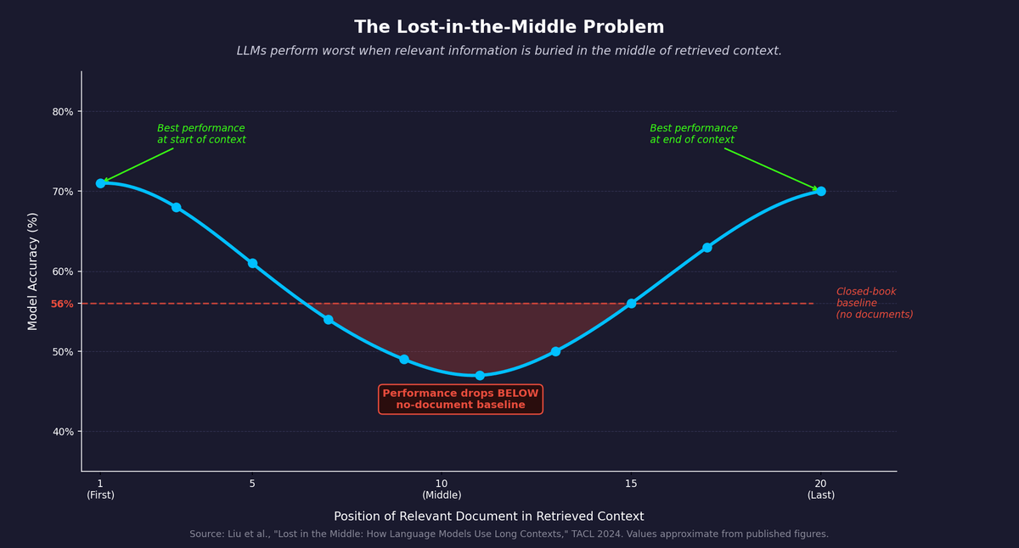
Maximum Context Is Not Always Usable Context
PRIMACY
strong
MIDDLE
weak
RECENCY
strong
Maximum context is a capacity limit—not a guarantee of uniform retrieval accuracy.
Notes:
[Sources]
- https://arxiv.org/abs/2307.03172
[/Sources]
[Sources]
- https://aclanthology.org/2024.tacl-1.9/
[/Sources]

Slide 72
Measure Effective Context Empirically
Useful context depends on the model, task, evidence position, noise, and evaluation method.
Evaluation protocol
Design response
Sweep evidence across beginning, middle, and end
Vary document length and distracting content
Measure task accuracy, citation quality, and abstention
Retrieve, rank, and compress evidence
Preserve source metadata
Reorder or chunk content for the target task
Use effective context as an internal benchmark, not a standardized model specification.
Notes:
[Sources]
- https://arxiv.org/abs/2307.03172
[/Sources]

Slide 73
Compare Context Windows Carefully
Advertised token limits are useful ceilings, but they do not imply equal usable context.
Model A
26k tokens
Model B
43k tokens
Model C
62k tokens
Tokenizer • modality • evidence position • task accuracy
Compare context windows with task-level accuracy, not token count alone.
Notes:
[Sources]
- https://arxiv.org/abs/2307.03172
[/Sources]

Slide 74
Latency and Throughput Are Different
Latency measures one user’s waiting time; throughput measures fleet work completed.
LOW LATENCY
HIGH THROUGHPUT
Fast first token
Small queues
Interactive service
User-level metric
More requests per second
Higher utilization
Batching
System-level metric
Optimize for both user experience and fleet-level economics.
Notes:
[Sources]
- Adapted and neutralized from GenAI in Business IS5542 - Lecture 1-2025.pptx, slide 67.
[/Sources]

Slide 75
Batching Trades Per-Request Latency for Fleet Throughput
Batching raises fleet utilization but can add waiting time for each request.
R1
R2
R3
R4
R5
R6
DYNAMIC BATCH
GPU
Choose a batching policy that matches service-level objectives, not peak throughput alone.
Notes:
[Sources]
- Adapted and neutralized from GenAI in Business IS5542 - Lecture 1-2025.pptx, slide 67.
[/Sources]

Slide 76
Cost Has Hidden Multipliers
Falling model prices do not automatically produce a low-cost GenAI system.
Input tokens
Output tokens
Retrieval + tools
TOTAL COST
=
Hosting
People + controls
Model the full input/output ratio and total cost of ownership before selecting an architecture.
Notes:
[Sources]
- Adapted and neutralized from GenAI in Business IS5542 - Lecture 1-2025.pptx, slide 69.
[/Sources]

Slide 77
Model Cost Depends on I/O and Deployment
Falling model prices do not automatically produce a low-cost GenAI system.
Input tokens
Output tokens
Retrieval + tools
TOTAL COST
=
Hosting
People + controls
Model the full input/output ratio and total cost of ownership before selecting an architecture.
Notes:
[Sources]
- Adapted and neutralized from GenAI in Business IS5542 - Lecture 1-2025.pptx, slide 70.
[/Sources]

Slide 78
Calculate Workload-Specific Total Cost
Total cost depends on usage patterns, service requirements, and deployment choices—not a single token price.
Variable usage cost
Deployment TCO
Input and output tokens
Reasoning, retries, retrieval, and tool calls
Model- and provider-specific pricing
API versus self-hosted infrastructure
Hardware, energy, staff, and monitoring
No universal breakeven point
Model representative workloads before choosing a deployment architecture.
Notes:
[Sources]
- Adapted and neutralized from GenAI in Business IS5542 - Lecture 1-2025.pptx, slide 70.
[/Sources]

Slide 79
Start Architecture Design with the Mission
No single system can maximize every objective at once. Begin by identifying the primary constraint.
User need
Quality need
Operating need
Required modality, responsiveness, and workflow integration.
Accuracy, reasoning depth, context, and acceptable failure modes.
Traffic volume, unit economics, governance, and deployment constraints.
Architecture follows mission priorities; secondary vectors are optimized within those constraints.
Notes:
[Sources]
- Adapted and neutralized from GenAI in Business IS5542 - Lecture 1-2025.pptx, slide 72.
[/Sources]

Slide 80
Two Missions Need Different Architectures
A real-time voice agent and a complex financial-analysis system may use the same model family but require different system designs.
Voice prioritizes low latency and native audio interaction.
Financial analysis prioritizes accuracy, reasoning, and large evidence sets.
The primary constraint determines the model, retrieval, and hardware choices.
There is no universally optimal GenAI stack.
Notes:
[Sources]
- Adapted and neutralized from GenAI in Business IS5542 - Lecture 1-2025.pptx, slide 73.
[/Sources]

Slide 81


Voice Agent vs. Financial Analysis
The same six vectors produce different architectures when business objectives change.
REAL-TIME VOICE AGENT
FINANCIAL ANALYSIS
STREAMING INTERACTION • FAST ESCALATION
EVIDENCE • TOOLS • HUMAN APPROVAL
Primary: latency + interaction
Short context
Streaming speech
Fallback to human
Primary: evidence + accuracy
Long context
RAG and calculation tools
Human approval
Optimize the architecture around the dominant failure cost for each mission.
Notes:
[Sources]
- Adapted and neutralized from GenAI in Business IS5542 - Lecture 1-2025.pptx, slide 74.
[/Sources]
[Sources]
- https://unsplash.com/illustrations/customer-service-representative-and-client-workspace-re6R5hiVTwo (voice-service illustration; accessed 2026-09-02)
- https://unsplash.com/photos/a-person-holding-a-piece-of-paper-over-a-laptop-9PwLeZA-RGc (financial-analysis photo; accessed 2026-09-02)
[/Sources]

Slide 82
Voice-Agent Architecture Starts with Interaction Latency
A voice agent must feel responsive while handling interruption and fallback.
Speech in
Streaming ASR
Fast LLM
Streaming TTS
Human fallback
Set response thresholds through user testing; no universal sub-500 ms rule applies.
Notes:
[Sources]
- Adapted and neutralized from GenAI in Business IS5542 - Lecture 1-2025.pptx, slide 74.
[/Sources]

Slide 83
Financial Analysis Prioritizes Evidence and Verification
A financial workflow should favor traceable evidence and controlled decisions over speed.
Question
Retrieve evidence
LLM + calculator
Citation check
Human approval
Latency is secondary to accuracy in this mission—but it is still measured.
Notes:
[Sources]
- Adapted and neutralized from GenAI in Business IS5542 - Lecture 1-2025.pptx, slide 74.
[/Sources]

Slide 84
Compound AI Matches Requests to Components
A coordinated system routes each request to the least expensive capable component.
Small model
User request
ROUTER
Knowledge + RAG
Code / tools
Human review
Compound AI improves cost and control through selective allocation—not merely a larger model.
Notes:
[Sources]
- Adapted and neutralized from GenAI in Business IS5542 - Lecture 1-2025.pptx, slide 77.
[/Sources]

Slide 85
A Router Assigns Work to the Right Specialist
A coordinated system routes each request to the least expensive capable component.
Small model
User request
ROUTER
Knowledge + RAG
Code / tools
Human review
Compound AI improves cost and control through selective allocation—not merely a larger model.
Notes:
[Sources]
- Adapted and neutralized from GenAI in Business IS5542 - Lecture 1-2025.pptx, slide 77.
[/Sources]

Slide 86
Six Principles for Architecture Decisions
Enterprise architecture is a multi-objective design problem.
Modality
Context
Latency
MISSION
FIT
Throughput
Performance
Cost
Improving one vector can weaken another; prioritize the dominant business failure cost.
Notes:
[Sources]
- Adapted and neutralized from GenAI in Business IS5542 - Lecture 1-2025.pptx, slide 79.
[/Sources]

Slide 87
Optimize for Fitness, Not Raw Strength
Enterprise AI architecture is a continuous learning process: measure the workload, observe failures, and rebalance the system.
Start with the business mission and risk tolerance.
Test the six vectors under realistic traffic and data.
Change routing, models, and controls as requirements evolve.
The goal is not the strongest system; it is the wisest system for the organization.
Notes:
[Sources]
- Adapted and neutralized from GenAI in Business IS5542 - Lecture 1-2025.pptx, slide 80.
[/Sources]

Slide 88
Part 3
Governing Probabilistic AI
Notes:
Traditional software usually follows explicit logic: the same valid input under the same configuration produces the same behavior. Generative models estimate probability distributions over possible outputs. Context, decoding settings, and model updates can change the result. This creates creativity and flexibility, but it also changes risk management. We cannot rely only on deterministic testing. We need distributional evaluation, monitoring, and controls that address a range of possible outcomes rather than one expected response.
[Sources]
- Adapted and neutralized from GenAI in Business IS5542 - Lecture 1-2025.pptx, slide 81.
[/Sources]
---
Generative behavior varies because of sampling, prompt and context differences, model updates, and imperfect data. Enterprises should respond with repeated evaluation across scenarios, monitoring for drift and incidents, and human review for high-impact decisions. Randomness is not the only source of failure; data, retrieval, tool use, and workflow design also matter. The correct control model combines statistical testing with operational governance. A single successful demonstration tells us almost nothing about reliability.
[Sources]
- Adapted and neutralized from GenAI in Business IS5542 - Lecture 1-2025.pptx, slide 81.
[/Sources]

Slide 89
Generative AI Produces Probability-Driven Outputs
Traditional software generally follows explicit logic; generative models estimate probability distributions over possible outputs.
Deterministic systems
Probabilistic systems
The same valid input follows predefined logic.
Behavior is easier to reproduce and test exhaustively.
Failures usually trace to code, data, or explicit configuration.
Outputs can vary with sampling, context, and model updates.
Capability comes from patterns learned from broad, imperfect data.
Testing must focus on distributions of outcomes and risk controls.
Practical mastery requires moving from speed-to-market toward accountable risk management.
Notes:
[Sources]
- Adapted and neutralized from GenAI in Business IS5542 - Lecture 1-2025.pptx, slide 81.
[/Sources]

Slide 90
Probabilistic Outputs Require a Different Control Model
GenAI behavior varies with context, sampling, model updates, and imperfect data, so one successful demo is not enough evidence.
What creates variation
How enterprises respond
Sampling and decoding choices
Prompt and context differences
Model updates and data limitations
Distributional evaluation across scenarios
Monitoring for drift and incidents
Human review for high-impact decisions
Creativity and risk share mechanisms, but randomness and data are not the only causes of failure.
Notes:
[Sources]
- Adapted and neutralized from GenAI in Business IS5542 - Lecture 1-2025.pptx, slide 81.
[/Sources]

Slide 91

Hallucinations Can Look Convincingly Correct
Language models optimize plausible continuation, not objective truth, so false statements can be delivered with confidence.
Legal example
Corporate example
In Mata v. Avianca, lawyers submitted fictitious citations generated by ChatGPT.
A federal court sanctioned the lawyers for failing to verify the material.
The chatbot said a bereavement fare could be claimed after travel; Air Canada’s published policy said it could not.
In 2024 BCCRT 149, the tribunal held Air Canada responsible for information delivered through its own service channel.
CHATBOT PROMISE ≠ PUBLISHED POLICY
Fluency must never be treated as evidence; high-stakes outputs require grounding and verification.
Notes:
[Sources]
- https://www.justice.gov/usao/media/1392531/dl
- https://www.canlii.org/en/bc/bccrt/doc/2024/2024bccrt149/2024bccrt149.html
[/Sources]
Teaching expansion: Moffatt relied on a customer-service chatbot that said a bereavement fare could be requested after travel. Air Canada’s published policy said retroactive claims were not allowed. The British Columbia Civil Resolution Tribunal treated the chatbot as part of Air Canada’s website and found negligent misrepresentation. The business lesson is that a company cannot treat an automated channel as outside its own accountability boundary; policy grounding, monitoring, and escalation are operational controls, not optional extras.
[Sources]
- https://unsplash.com/photos/man-talking-on-phone-in-airport-waiting-area-RGZ90Pwo80w (airport-service photo; accessed 2026-09-02)
- https://www.americanbar.org/groups/business_law/resources/business-law-today/2024-february/bc-tribunal-confirms-companies-remain-liable-information-provided-ai-chatbot/ (case summary; accessed 2026-09-02)
[/Sources]

Slide 92

Ground Probabilistic Systems
Risk controls should reduce uncertainty before generation, capture observable system actions during execution, and verify outcomes afterward.
Ground answers in approved evidence.
Log sources, tool calls, validation checks, and approvals.
Escalate consequential decisions to qualified people.
GROUND • LOG • VALIDATE • ESCALATE
No single control is sufficient; reliable systems use layers of prevention, detection, and review.
Notes:
[Sources]
- Adapted and neutralized from GenAI in Business IS5542 - Lecture 1-2025.pptx, slide 84.
[/Sources]
[Sources]
- https://unsplash.com/photos/person-holding-pencil-near-laptop-computer-5fNmWej4tAA (human review photo; accessed 2026-09-02)
[/Sources]

Slide 93
RAG, Reasoning, and Human Review
Three complementary controls address different failure modes.
RAG
Ground in evidence
REASONING
Decompose + verify
HUMAN REVIEW
Approve high impact
evidence
observable steps
accountability
Grounding improves factuality; workflow supports audit; review manages residual risk.
Notes:
[Sources]
- Adapted and neutralized from GenAI in Business IS5542 - Lecture 1-2025.pptx, slide 85.
[/Sources]

Slide 94
Build an Evidence Chain, Not a Chain of Thought
A generated rationale may be useful, but it is not guaranteed to faithfully describe the model’s internal decision process.
Grounded sources
Observable actions
Human accountability
Retrieve approved evidence, preserve provenance, and require citations or abstention.
Log tool calls, checks, intermediate artifacts, model versions, and policy decisions.
Assign qualified review and approval for high-impact decisions and exceptions.
Audit what the system did and what evidence it used; do not treat hidden reasoning as an audit record.
Notes:
[Sources]
- https://www.anthropic.com/research/measuring-faithfulness-in-chain-of-thought-reasoning
[/Sources]

Slide 95
GenAI Expands the Cyber Attack Surface
Natural-language interfaces add new paths for instructions, data, and tool misuse.
Prompt injection
Tool abuse
GENAI SYSTEM
Poisoned retrieval
Identity gaps
Treat the model, tools, retrieved data, and user interface as one security boundary.
Notes:
[Sources]
- Adapted and neutralized from GenAI in Business IS5542 - Lecture 1-2025.pptx, slide 87.
[/Sources]

Slide 96
Defend with Testing, Provenance, and Guardrails
Security controls should challenge the system continuously and constrain what it can accept, access, and release.
RED TEAM
CONTENT PROVENANCE
INPUT / OUTPUT FILTERS
PERMISSION BOUNDARIES
Security is a lifecycle discipline—not a one-time model evaluation.
Notes:
[Sources]
- Adapted and neutralized from GenAI in Business IS5542 - Lecture 1-2025.pptx, slide 88.
[/Sources]

Slide 97
Security Incidents Expose Authority and Identity Gaps
GenAI incidents become costly when a model is given authority without constraints or when people cannot verify identity.
Prompt injection
Deepfake impersonation
Enterprise controls
A Chevrolet chatbot was induced to claim it would sell a vehicle for $1; no completed sale occurred.
Hong Kong police reported a 2024 pre-recorded deepfake video-conference fraud causing about HK$200 million in losses.
Limit tool authority, verify transactions out of band, log actions, and require approval for high-value changes.
Treat models as untrusted decision participants unless identity, authority, and consequences are controlled.
Notes:
[Sources]
- https://www.aiaaic.org/aiaaic-repository/ai-incidents/chevrolet-dealerships-chatbot-promises-vehicle-for-1
- https://www.info.gov.hk/gia/general/202406/26/P2024062600192.htm
[/Sources]

Slide 98
How Sensitive Data Can Leak
Natural-language interfaces add new paths for instructions, data, and tool misuse.
Prompt injection
Tool abuse
GENAI SYSTEM
Poisoned retrieval
Identity gaps
Treat the model, tools, retrieved data, and user interface as one security boundary.
Notes:
[Sources]
- Adapted and neutralized from GenAI in Business IS5542 - Lecture 1-2025.pptx, slide 90.
[/Sources]

Slide 99
Protect Data Across the Model Lifecycle
Privacy controls should reduce what is shared and limit how long it remains identifiable.
COLLECT
PREPARE
TRAIN / RETRIEVE
DEPLOY
MONITOR
minimize
sanitize
isolate
control access
audit + delete
Combine technical controls with access policy, training, logging, and incident response.
Notes:
[Sources]
- Adapted and neutralized from GenAI in Business IS5542 - Lecture 1-2025.pptx, slide 91.
[/Sources]

Slide 100

The Samsung Incident Was a Data-Disclosure Failure
Employees pasted proprietary code and meeting information into an unapproved public service.
Sensitive data
Public GenAI service
External processing
Disclosure risk
THE GOVERNANCE FAILURE
Sensitive data left the controlled environment before any downstream model behavior needed to be assumed.
PROPRIETARY CODE → PUBLIC SERVICE
Govern the data sent to external services; do not overstate unverified downstream model behavior.
Notes:
[Sources]
- https://techcrunch.com/2023/05/02/samsung-bans-use-of-generative-ai-tools-like-chatgpt-after-april-internal-data-leak/
[/Sources]
[Sources]
- https://unsplash.com/photos/people-coding-at-monitors-in-workspace-Im_cQ6hQo10 (developer workspace photo; accessed 2026-09-02)
[/Sources]

Slide 101
Training Data Raises a Rights Question
Learning from public content does not automatically resolve whether collection, transformation, or reuse is authorized.
Was the material licensed, public-domain, or subject to an applicable exception?
Did the source communicate a contractual, access-control, or machine-readable restriction?
Can the model reproduce protected expression or proprietary information?
IP risk begins with data provenance and continues through model outputs and downstream use.
Notes:
[Sources]
- Adapted and neutralized from GenAI in Business IS5542 - Lecture 1-2025.pptx, slide 93.
[/Sources]

Slide 102
Copyright Risk Has Two Sides
Enterprise exposure can arise from both training material and generated output.
TRAINING-DATA RISK
OUTPUT RISK
Provenance and licensing
Copyrighted sources
Personal and sensitive data
Opt-out obligations
Memorized similarity
Protected characters or code
Trademark and defamation
Use and approval process
Treat model procurement, training data, generated content, and publication as connected IP decisions.
Notes:
[Sources]
- Adapted and neutralized from GenAI in Business IS5542 - Lecture 1-2025.pptx, slide 94.
[/Sources]

Slide 103
Use Licensing, Contracts, and Opt-Outs
Responsible data sourcing requires documented rights, clear allocation of liability, and attention to technical and contractual signals.
Licensing
Indemnification
Technical and legal signals
Acquire authorized datasets directly or through collective agreements with publishers, archives, and stock-media providers.
Negotiate vendor responsibilities and protection for claims arising from approved model use.
Treat robots.txt and other machine-readable preferences as governance inputs alongside access controls, contracts, licenses, and applicable law.
A defensible AI supply chain is built on provenance, permission, and accountable contracts.
Notes:
[Sources]
- Adapted and neutralized from GenAI in Business IS5542 - Lecture 1-2025.pptx, slide 95.
[/Sources]

Slide 104
Copyright Risk Depends on Rights, Use, and Jurisdiction
Training and output questions must be assessed separately, and the legal answer can differ across jurisdictions and use cases.
Provenance
Contracts
Technical signals
Document where training, retrieval, and evaluation content came from and the rights attached to it.
Review licenses, vendor terms, indemnities, restrictions, and responsibilities for downstream use.
Use access controls and machine-readable preferences as evidence, not as universal legal rules.
Copyright governance requires qualified legal analysis, documented provenance, and operational controls.
Notes:
[Sources]
- Adapted and neutralized from GenAI in Business IS5542 - Lecture 1-2025.pptx, slide 95.
[/Sources]

Slide 105
Models Inherit Bias and Lose Diversity
Bias can enter through data, objectives, evaluation, deployment, and feedback.
DATA
representation
MODEL
objective
METRICS
error gaps
DEPLOYMENT
access
FEEDBACK
correction
No single fairness metric is universally correct; goals and trade-offs must be documented.
Notes:
[Sources]
- Adapted and neutralized from GenAI in Business IS5542 - Lecture 1-2025.pptx, slide 97.
[/Sources]

Slide 106
Fairness Requires Data, Metrics, and Feedback
Fairness is an operating process that begins before training and continues through deployment monitoring.
Data curation
Evaluation metrics
Human feedback
Re-sample, filter, and document datasets to improve demographic balance and representation.
Select measures such as demographic parity or equalized odds that match the decision context.
Use expert review, diverse raters, and explicit behavioral principles, while recognizing that human feedback alone cannot guarantee fairness.
No single fairness metric is universally correct; goals and trade-offs must be documented.
Notes:
[Sources]
- Adapted and neutralized from GenAI in Business IS5542 - Lecture 1-2025.pptx, slide 98.
[/Sources]

Slide 107
Fairness Requires Context-Specific Evidence
Fairness cannot be established by a single demographic statistic or a universal metric; it depends on the decision and affected stakeholders.
Data
Evaluation
Governance
Examine representation, label quality, historical bias, missing groups, and lawful collection.
Choose outcome and error metrics that match the decision context, then test affected groups.
Document trade-offs, involve domain experts and affected stakeholders, monitor, and provide recourse.
Human feedback can help, but it does not replace context-specific fairness goals, evidence, and accountability.
Notes:
[Sources]
- Adapted and neutralized from GenAI in Business IS5542 - Lecture 1-2025.pptx, slide 98.
[/Sources]

Slide 108

Responsible AI Extends Beyond the Model
Enterprise risk includes infrastructure impact, opaque suppliers, and the way people interpret and rely on AI outputs.
Environmental impact
Value-chain opacity
Human–AI interaction
Training and inference consume energy, water, and hardware; measure and optimize the workload rather than relying on averages.
Third-party models, data, and infrastructure can hide provenance, labor, security, and compliance risks.
A medical chatbot can sound authoritative even when uncertain. High-impact advice needs clinician review and a clear escalation path.
MEDICAL CHATBOT → CLINICIAN ESCALATION
Govern the full socio-technical system: suppliers, infrastructure, interfaces, users, and decisions.
Notes:
[Sources]
- Adapted and neutralized from GenAI in Business IS5542 - Lecture 1-2025.pptx, slide 100.
[/Sources]
[Sources]
- https://unsplash.com/photos/doctor-consulting-with-a-patient-in-an-office-MJmsLpeHPfg (medical consultation photo; accessed 2026-09-02)
[/Sources]

Slide 109
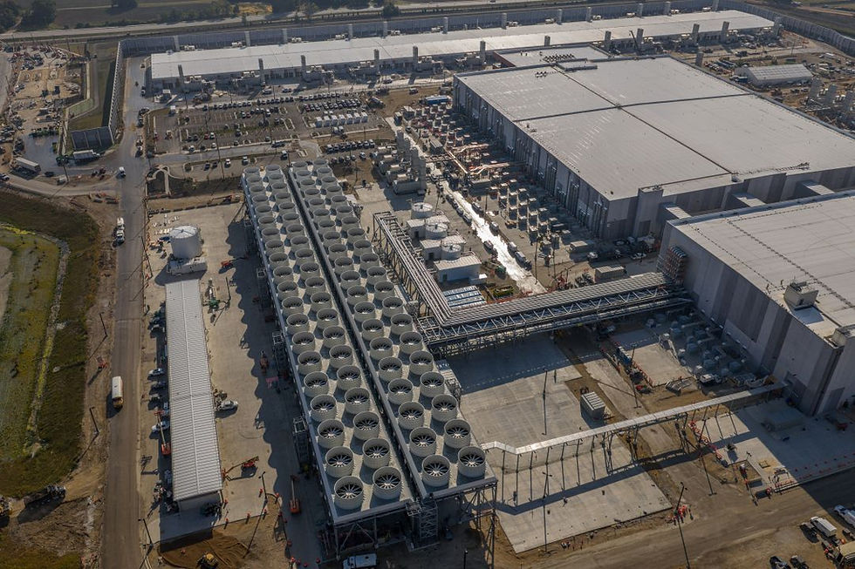
Environmental Impact Must Be Measured, Not Averaged
ENERGY
WATER
HARDWARE
Report workload, region, utilization, and uncertainty—not a universal per-query number.
Environmental impact must be measured in context, not reduced to a single average.
Notes:
[Sources]
- https://doi.org/10.1145/3724499
[/Sources]
[Sources]
- https://www.tpssi.com/post/exploring-the-superior-engineering-of-cooling-towers-by-baltimore-aircoil-company
[/Sources]

Slide 110
Responsible AI Covers the Entire Value Chain
Accountability spans data and model suppliers, application builders, deployers, users, and affected stakeholders.
Supply chain
Human–AI interaction
Disclosure
Use model and data documentation, AIBOM/SBOM practices, vendor assessment, and provenance records.
Design permissions, review, escalation, feedback, recourse, and accessibility into the workflow.
Disclose AI involvement when required by context, organizational policy, contract, or law.
Responsibility does not stop at the model boundary; it follows the business process and its impacts.
Notes:
[Sources]
- Adapted and neutralized from GenAI in Business IS5542 - Lecture 1-2025.pptx, slide 100.
[/Sources]

Slide 111
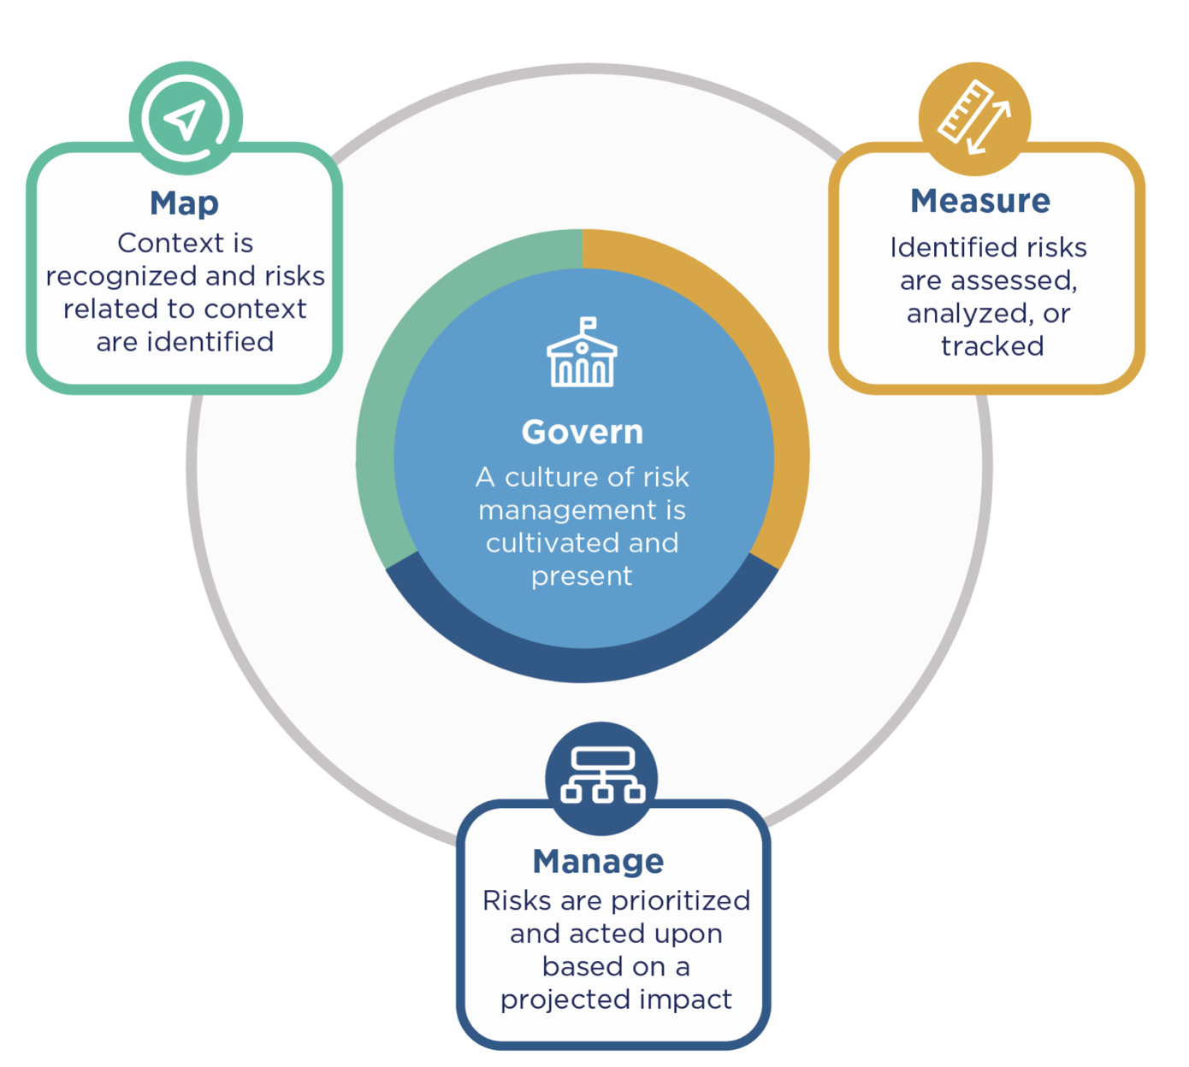
NIST AI RMF Provides a Common Risk Language
NIST AI RMF organizes risk work into four connected functions.
GOVERN — cross-cutting
MAP — context
MEASURE — evidence
MANAGE — action
The framework creates a common risk language—not a certification or one-time checklist.
Notes:
[Sources]
- https://www.nist.gov/publications/artificial-intelligence-risk-management-framework-ai-rmf-10
[/Sources]
[Sources]
- https://www.nist.gov/itl/ai-risk-management-framework
[/Sources]

Slide 112
Part 4
Operationalizing Responsible AI
Notes:
The NIST AI Risk Management Framework is voluntary and non-sector-specific. It gives business, technical, legal, and risk teams a shared vocabulary for discussing AI across the lifecycle. Organizations can use it to frame context, evidence, accountability, and action, and then connect it to existing governance and incident-response processes. The framework is not a certification or a one-time checklist. Its value comes from helping diverse teams organize ongoing risk work consistently.
[Sources]
- https://www.nist.gov/publications/artificial-intelligence-risk-management-framework-ai-rmf-10
[/Sources]

Slide 113
Govern, Map, Measure, Manage
NIST AI RMF organizes risk work into four connected functions.
MAP
GOVERN
MANAGE
MEASURE
The framework creates a common risk language—not a certification or one-time checklist.
Notes:
[Sources]
- https://www.nist.gov/publications/artificial-intelligence-risk-management-framework-ai-rmf-10
[/Sources]
[Sources]
- https://airc.nist.gov/airmf-resources/airmf/5-sec-core/ (AI RMF Core functions, continuous and iterative operation, and cross-cutting GOVERN; accessed 2026-08-22)
[/Sources]
[Sources]
- https://www.nist.gov/itl/ai-risk-management-framework
[/Sources]

Slide 114
NIST AI RMF Is Continuous and Iterative
NIST AI RMF organizes risk work into four connected functions.
MAP
GOVERN
MANAGE
MEASURE
The framework creates a common risk language—not a certification or one-time checklist.
Notes:
[Sources]
- https://www.nist.gov/publications/artificial-intelligence-risk-management-framework-ai-rmf-10
[/Sources]
[Sources]
- https://airc.nist.gov/airmf-resources/airmf/5-sec-core/ (AI RMF Core functions, continuous and iterative operation, and cross-cutting GOVERN; accessed 2026-08-22)
[/Sources]

Slide 115
GOVERN and MAP Set Direction
The first two functions establish accountability and determine whether the use case is appropriate.
1. GOVERN
2. MAP
Ownership
Policies and roles
Accountability structures
Escalation rights
Purpose and context
Stakeholders and harms
Benefits and limits
Risk tolerance
Good governance decides who is accountable; good mapping decides what is in scope.
Notes:
[Sources]
- https://airc.nist.gov/airmf-resources/airmf/5-sec-core/
[/Sources]
[Sources]
- https://airc.nist.gov/airmf-resources/playbook/
[/Sources]

Slide 116
MEASURE and MANAGE Put Evidence into Action
The final two functions turn testing evidence into prioritized treatment and accepted residual risk.
3. MEASURE
4. MANAGE
Metrics and test sets
Security and fairness
Uncertainty
Continuous monitoring
Prioritize treatment
Deploy controls
Assign owners
Accept residual risk
Measurement informs action; management records what is treated, transferred, accepted, or escalated.
Notes:
[Sources]
- https://airc.nist.gov/airmf-resources/airmf/5-sec-core/
[/Sources]
[Sources]
- https://airc.nist.gov/airmf-resources/playbook/
[/Sources]

Slide 117
The Goal Is Acceptable Risk, Not Zero Risk
Probabilistic systems cannot eliminate uncertainty, but organizations can govern it to explicit tolerances.
risk tolerance
ACCEPT
REVIEW
REDUCE
Select architecture and controls so residual risk is explicit, monitored, and acceptable.
Notes:
[Sources]
- Adapted and neutralized from GenAI in Business IS5542 - Lecture 1-2025.pptx, slide 108.
[/Sources]

